Slide 1
Advanced Sorting - II
Lecture # 13

Slide 2
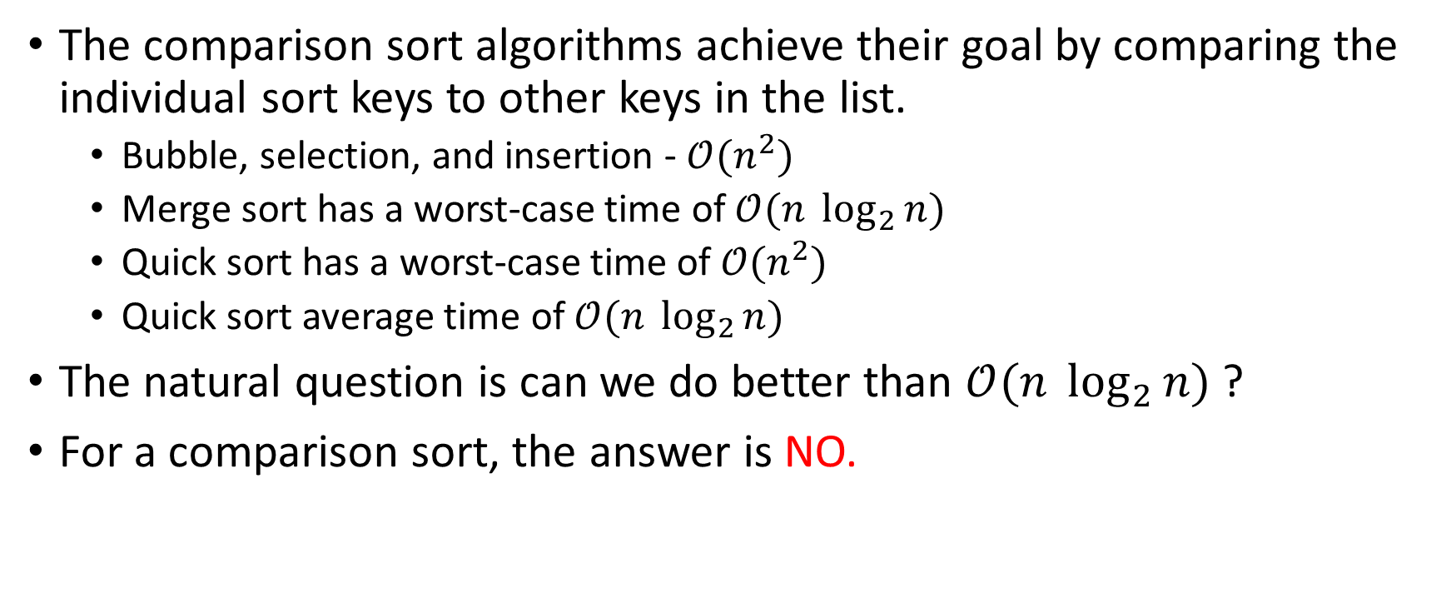
How Fast Can We Sort?
The comparison sort algorithms achieve their goal by comparing the individual sort keys to other keys in the list.
Bubble, selection, and insertion - $𝒪(n^{2})$
Merge sort has a worst-case time of $𝒪(n \log_{2}{n})$
Quick sort has a worst-case time of $𝒪(n^{2})$
Quick sort average time of $𝒪(n \log_{2}{n})$
The natural question is can we do better than $𝒪(n \log_{2}{n})$ ?
For a comparison sort, the answer is NO.

Slide 3
How Fast Can We Sort?
Distribution sort algorithms use techniques other than comparisons among the keys themselves to sort the sequence of keys.
While these distribution algorithms are fast, they are not general-purpose sorting algorithms.
These algorithms are used when the keys have certain characteristics and for specific types of applications.

Slide 4
Radix Sort
Radix sort is a fast distribution sorting algorithm that orders keys by examining the individual components of the keys instead of comparing the keys themselves.
For example, when sorting integer keys, the individual digits of the keys are compared from least significant to most significant.
The radix sort algorithm also known as bin sort can be traced back to the time of punch cards and card readers.
Card readers contained a number of bins in which punch cards could be placed after being read by the card reader.
To sort values punched on cards the cards were first separated into 10 different bins based on the value in the ones column of each value.
The cards were then sorted again, but this time by the tens column. The process continued until the cards were sorted by each digit in the largest value.

Slide 5

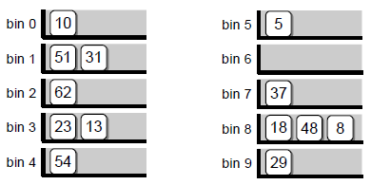
Radix Sort
Consider the following array,
Gather the keys back into
the array.
D
Distribute the keys across the bins
based on the tens column.
C

Slide 6
Radix Sort - Implementation
Important algorithm points,
The individual bins store groups of keys based on the individual digits.
Keys with duplicate digits (in a given column) are stored in the same bin, but following any that are already there.
When the keys are gathered from the bins, they have to be stored back into the original sequence. This is done by removing them from the bins in a first-in-first-out ordering.

Slide 7
Radix Sort - Implementation
def radixSort( intList, numDigits ): # Create an array of queues to represent the bins. binArray = Array( 10 ) for k in range( 10 ): binArray[k] = Queue() # The value of the current column. column = 1 # Iterate over the number of digits in the largest value. for d in range( numDigits ): # Distribute the keys across the 10 bins. for key in intList : digit = (key // column) % 10 binArray[digit].enqueue( key ) | # Gather the keys from the bins and place them back in intList. i = 0 for bin in binArray : while not bin.isEmpty() : intList[i] = bin.dequeue() i += 1 # Advance to the next column value. column *= 10 return intList

Slide 8
Radix Sort – Efficiency Analysis

